Slide 1
UNDERSTANDING AND COMPLYING WITH THE BUILDING SAFETY ACT 2022 A Guide for Landlords and Leaseholders in Camden
Presented By
T.A.Y. professional consultants

Slide 2

BACKGROUND
In 2017, due to the tragic fire at Grenfell Tower, a high-rise block in West London, that resulted in the deaths of 72 residents. The government immediately ordered a public inquiry into the fire.
In October 2019, the findings were published and it included many important recommendations to prevent such a tragedy from ever happening again. G [put regs in place

Slide 3
New Regulatory Bodies
The Building Safety Act establishes three new agencies to oversee building safety:
The Building Safety Regulator (BSR) - Responsible for regulating the design, construction, and ongoing safety of higher-risk buildings.
The National Regulator of Construction Products (NRCP) - Oversees the safety of construction products used in buildings.
The New Homes Ombudsman (NHO) - Provides a dispute resolution service for homeowners experiencing issues with new build properties.

Slide 4
OUTLINE OF PRESENTATION?
WHO THE REGULATION APPLIES TO
WHAT TO DO TO COMPLY WITH REGULATION
WHERE NON-COMPLIANCE STEPS TO BE TAKEN
CONSEQUENCES OF NON-COMPLIANCE

Slide 5
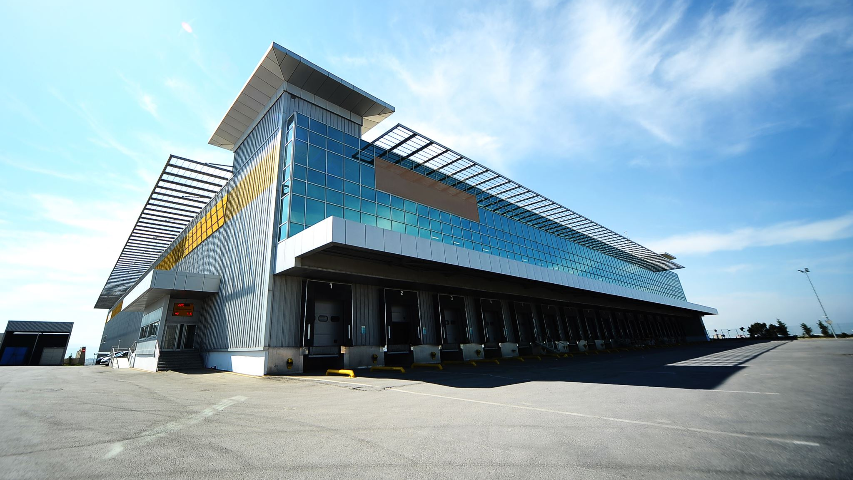
Buildings Covered by the New Requirements
The new fire safety rules apply to new or existing occupied buildings over 18 meters high or seven storeys or more which contains at least two residential units.
Contains common parts through which residents would need to evacuate during emergencies.

Slide 6

Understanding New Responsibilities
“Responsible Person” Any person who has:
Control of the premises in connection with carrying on a business.
The freeholder or the managing agents for the block
A resident or a management company.
The employer, where the premises is a workplace

Slide 7
Compliance Requirements FOR LANDLORDS
For All Buildings
Assess Your Building: Determine if your building falls under the scope of the new regulations.
Understanding Responsibilities: Familiarize yourself with the duties imposed by the Act and the Fire Safety Regulations
Engaging With Residents: Inform tenants about the changes and their implications.
For Historical Buildings
Consult Experts: Seek advice on how to preserve the building while enhancing safety measures.
Review Safety Plans: Update your fire and structural safety plans to align with the new standards.

Slide 8
COMPLIANCE REQUIREMENTS FOR LANDLORDS- CONTINUED
Building Safety Information Registration: (Expected April 2024) You will be required to register relevant building safety information with the Building Safety Regulator, including details about the building, materials used, fire safety measures, and any identified risks.

Slide 9



ENSURING COMPLIANCE WITH Fire Safety Regulations
Fire Safety Assessment: Identify the fire safety risks in your building and take necessary steps to mitigate them.
Conduct Regular Checks: Perform quarterly checks on communal fire doors and annual checks on flat entrance doors. This is to ensure that all fire doors in your building are self-closing and in good working order
Maintain Records: Keep an updated record of fire safety assessments and actions taken.
Install Safety Features: Ensure wayfinding signage and firefighting equipment are in place and regularly inspected. Fire alarms and detection systems should be maintain and tested regularly as per manufacturer's instructions.

Slide 10

NON COMPLIANCE
If Non-Compliance Occurs:
Immediate Action: Address any issues of non-compliance as soon as they are identified. Consider seeking advice from a qualified fire safety professional to assess the situation and recommend any necessary action.
Proactive Communication: If you are contacted by a resident regarding a potential fire safety non-compliance issue, it's crucial to address it promptly and transparently.
Notify Authorities: Inform the relevant regulatory body about the non-compliance and the steps taken to rectify it.
Seeking Assistance: Access support services from regulatory agencies and seek legal counsel if needed
Prevent Recurrence: Implement measures to prevent future non-compliance.

Slide 11

NON COMPLIANCE - CONTINUED
Responding to Non-Complying Premises:
Investigate Claims: Thoroughly investigate any claims of non-compliance.
Take Corrective Measures: Rectify any valid issues promptly.
Document Actions: Keep detailed records of the investigation and corrective measures taken.

Slide 12
OFFENCES And PENALTY FOR NON Compliance
Obstruction of a regulator or authorised person from carrying out inspection or other function towards a building and is liable on summary conviction to a fine.
Provision of false or misleading information to regulator.
Contravention of a compliance notice issued for non-compliance with a or likely noncompliance with a building regulation, without reasonable excuse.
Contravention of a stop notice.
Occupation of a relevant residential unit or part of it before a completion certificate is issued.

Slide 13
CONSEQUENCE OF NON COMPLIANCE

Slide 14
CONCLUSION
Compliance with the Building Safety Act 2022 and the Fire Safety (England) Regulations 2022 is crucial for the safety of your tenants and the longevity of your property. As landlords, we all have a responsibility to ensure the safety of our tenants.
By following this guide, you will be better equipped to meet your legal obligations and ensure the safety of your building.
Effective communication and prompt action are key to achieving compliance.

Slide 15

THANK YOU

